Slide 1

Remember anything with
Spaced repetition learning
Notes:
Hey!
I’d like to tell you about a “remembering slash learning” technique called Spaced Repetition Learning.
Let’s start by looking at how our memory works..

Slide 2
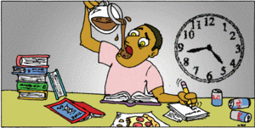
https://rosslyneaglewatch.wordpress.com/2014/05/15/studiers-vs-crammers/
Notes:
Exemplified by this guy.
This was me. And I’m sure a lot of you can relate as well. Cramming for tomorrows exam. Trying to push in as much knowledge as possible in as short time as possible.
And it kinda worked - at least sometimes. I remembered a whole bunch of the newly learned “bits of knowledge” during the exam, but the problem with this approach is that the knowledge doesn’t stick. Even walking out of the examination area I’d started to forget stuff.
And that’s obvious, right? What you you learn but don’t reinforce, what you don’t repeat - it just won’t stick.

Slide 3
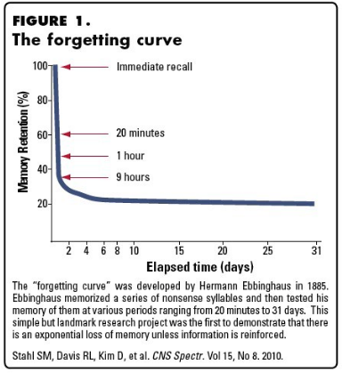
Notes:
Take a look at this graph:
On the x-axis we have elapsed time, in days.
On the y-axis we have retention: How well you remember what you’ve learned.
Let’s say you learned something at day zero. Without reinforcing/repeating it, a typical “forgetting curve” will look like this. You’ll forget what you’ve learned very fast.
And at day zero here, that’s where we have the student cramming for tomorrow’s exam. He’ll remember a lot of stuff, but the knowledge disappears quickly.
This graph was published in 1885. My calculator tells me that’s 133 years ago. We’ve known this for so long, but still so many don’t methodically repeat or reinforce the things they want to learn in order to not forget it.

Slide 4
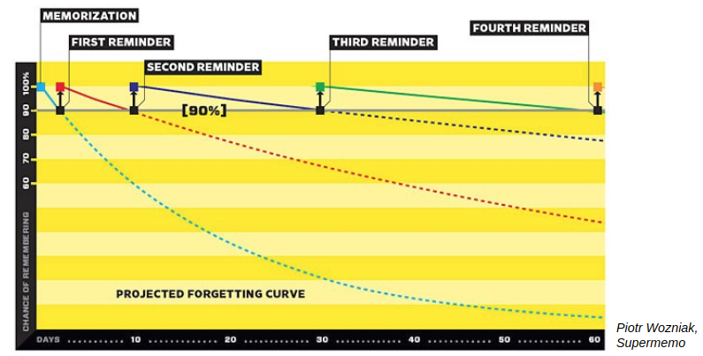
Notes:
IF HOWEVER you were to repeat and reinforce the things you learn in growing time intervals, the forgetting curve could look like this.
See that the forgetting curve starts to fall down immediately after learning has taken place. But that every time you reinforce what you’ve learned, the curve flattens out more and more.
This is how our brains work, and this is the key observation. If we learn something, and then reinforce that knowledge right before we’re about to forget it - in increasing intervals - we’ll remember it better and better.

Slide 5
The challenges
How can we track what we’ve learned?
How can we make sure to reinforce/repeat that knowledge right before we’re about to forget it?
Notes:
So then we have a couple of challenges:
How can we track what we’ve learned?
How can we make sure to reinforce/repeat that knowledge right before we’re about to forget it?
Because if we can find a solution to these two, then we’ll be able to flatten out our forgetting curves.
The solution to these challenges is of course...

Slide 6
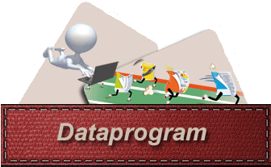
The solution
Notes:
A computer program. Or a “dataprogram”, på godt norsk.

Slide 7
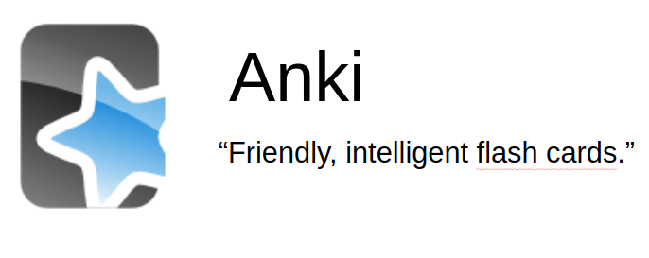
The solution
Notes:
Specifically, a computer program named Anki.
Anki has the tagline “Friendly, intelligent flash cars”
So what is meant by flashcards?

Slide 8
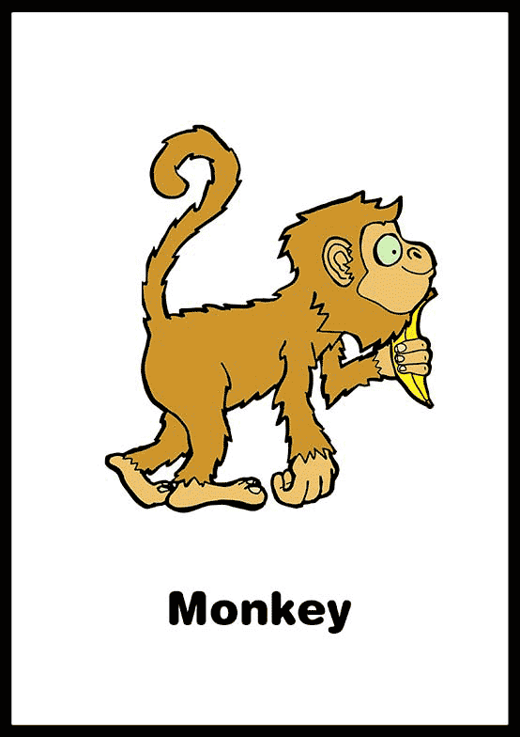
Flash cards??
Notes:
Let’s say I’m learning German, and I’d like to learn the german work for “monkey”. Then I could create this flashcard.
On one side, it’s telling me what the name is in english - a language that i know.
On the other side, it’s telling me what a monkey is in german.
What I do then, when studying, is to have a whole bunch of these manually created flash cards, look at a card, and try to guess or remember what it says on the other side.
If the answer was easy for me to remember, then I’ll make a note of that and put the card in a new deck for “cards that was easy to me to remember”. That’s the deck I won’t need to review for a while, since it was easy for me to recall the answers.
If the answer was difficult or impossible for me to remember, then I’ll put that card in the deck for “difficult cards”. The cards that I’ll review again shortly.
Separating flash cards like that, based on how well you were able to recall, is what “intelligent flashcards” mean. I could of course do that manually and keep track of a bunch of decks of actual flash cards.. oooor I could use a software that takes care of it for me.

Slide 9
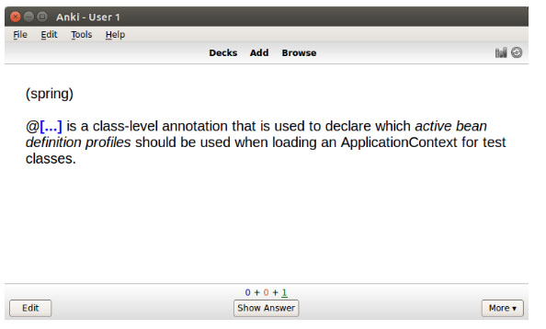
Notes:
Enter Anki!
This is an example of a flash card in my Java deck.
In this card I’ve hidden some key piece of information - the thing I’m trying to learn. I’d like to learn which annotation I can use when declaring which active bean definition profiles should be used when loading an applicationcontext for test classes.
And hey - don’t diss spring.
The answer to this flash card is...

Slide 10
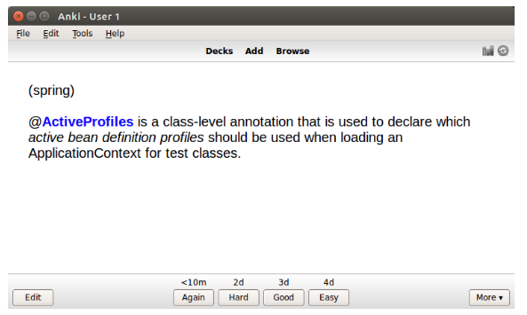
Notes:
@ActiveProfiles.
Now, notice the buttons that appeared at the bottom here. This is where the “intelligent” part of these flash cards come in.
I can tell Anki how easy it was to answer this flash card, and based on my response, Anki will schedule that card for a new review sometime in the future!
If it was very easy for me to answer, I’ll use the button farthest to the right. And then Anki will push the next review of this card 4 days into the future.
If I couldn’t answer, I’ll use the button farthest to the left. Then I’ll see the card again in 10 minutes.
The result of this is that I’ll only be spending time on the things I haven’t yet learned. What I already know I won’t waste time on!

Slide 11
Notes:
Remember this? :)
Anki keeps track of the increasing intervals for me, and the forgetting curve starts to flatten!
Anki has sane default values for how much the time intervals should increase based on the user feedback - defaults based on research on the topic.

Slide 12
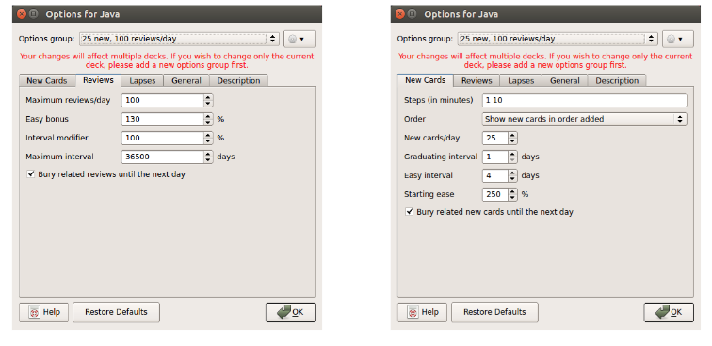
Notes:
But everything is of course 100% customizable.
If you’re trying to learn something difficult, you can get anki to lower the time intervals between reviews.
If you’re trying to learn something easy, you can get anki to increase the intervals.

Slide 13
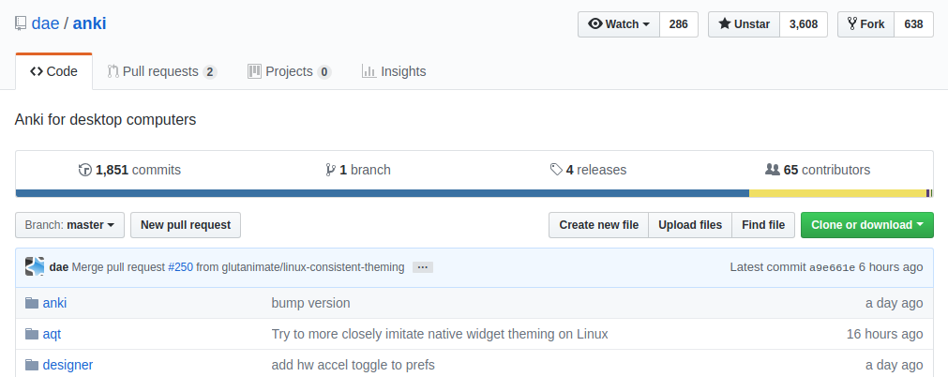
Notes:
Anki is open source and under active development. I just took this screenshot, and the latest change was six hours ago!
There’s also a ton of plugins available that’ll let you do syntax highlighting of code, organize stuff in tables, record sound, etc.

Slide 14
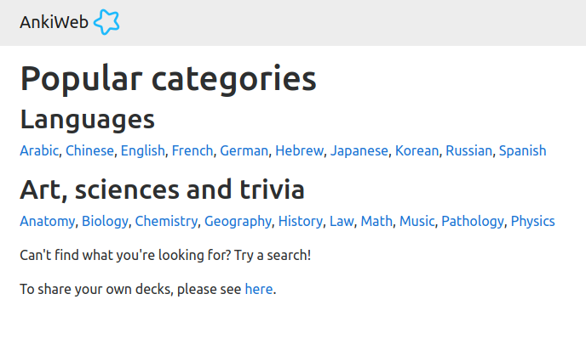
Notes:
Also, people are contributing decks of flash cards. If you want to learn something, there’s probably already someone who have many a deck for it. You just have to look through the catalogue.

Slide 15
Demo!
Notes:
Let’s break out of the presentation and take a look at some of my decks!

Slide 16

Notes:
Anki was a fantastic tool to have during my time at the university, but it has also proven to be very helpful in “professional life” as a developer.
We use a lot of different technologies, frameworks, and tools in our trade. And when we work on so many different things there will be some things that we only touch on every now and then.
And since there might be a few weeks between each time I touch that specific codebase or system, then I might’ve forgotten a thing or two about it. I might have to google something that I’m POSITIVE that I’ve googled before.
Some examples are:
Which annotation was it that let me decide which spring bean should be injected here?
or, How was the syntax of streams().map() in Java different from map in Scala?
or, which hotkey was it that allowed me to see the call hierarchy of a function in Intellij?
There are TONS of examples like this that would make up nice flashcards. And then Anki will make sure that the knowledge is stuck in my mind.
You can also create flash cards for design patterns, best practices, etc etc etc

Slide 17
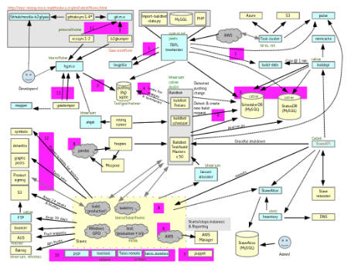
Notes:
You can also create flash cards to describe the incredibly complex system you’re working on.

Slide 18
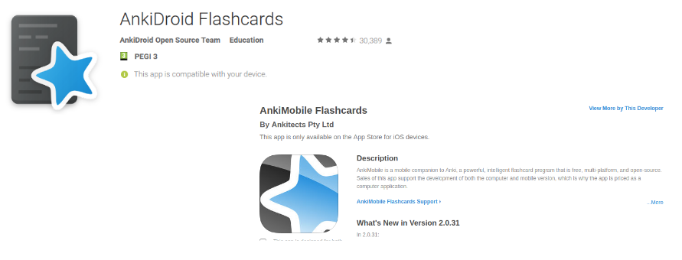
Notes:
In addition to the desktop version of Anki, which works for mac, windows and linux, there are apps for both Android and iOS.
I use AnkiDroid myself, every day on the bus on my way to work.

Slide 19
Notes:
So let’s go all the way back and reinforce a few things...

Slide 20
What have we learned?
We forget stuff all the time
We forget because we do not reinforce
The best time to reinforce is right before we’re about to forget
If we reinforce right when we’re about to forget, we will gradually remember it longer and longer
Notes:
We’ve learned that..

Slide 21
Notes:
Because we want to avoid the forgetting curve going all the way down. We want to keep it flat.

Slide 22
The challenges
How can we track what we’ve learned?
How can we make sure to reinforce/repeat that knowledge right before we’re about to forget it?
Notes:
So then we had a couple of challenges:
How can we track what we’ve learned?
How can we make sure to reinforce/repeat that knowledge right before we’re about to forget it?
Because if we can find a solution to these two, then we’ll be able to flatten out our forgetting curves.
The solution to these challenges is of course...

Slide 23
The solution
Notes:
Specifically, a computer program named Anki.
Anki has the tagline “Friendly, intelligent flash cars”
So what is meant by flashcards?

Slide 24
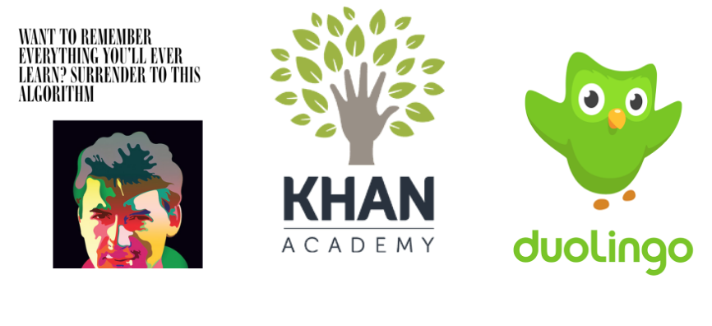
Notes:
And it really works. People are writing about it.
Khan academy, duolingo, and many many others are using spaced repetition to help students retain knowledge.

Slide 25
Questions?

